Slide 1
Film History
An illustrated timeline
LO1 – Assess the growth of the film industry and audiences
Notes:
https://seanmcgrory.weebly.com/

Slide 2
Pre Classical Cinema: 1888 -1915
Thomas Edison Invents Kinetograph/ Kinetoscope
Lumiere Bros
Georges Melies – A Trip to the Moon (1902)
D.W Griffiths – Birth of a Nation (1915)

Slide 3
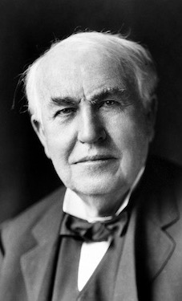
Thomas Edison
In 1888, there is the invention of the motion camera named the Kinetograph. It was designed by Thomas Edison and co.
They were also responsible for the kinetoscope, a peep hole motion picture viewer.
Edison and Co also would go on to produce films for public consumption, most of the early films would consist of live events taking place.
Notes:
References:
https://www.loc.gov/collections/edison-company-motion-pictures-and-sound-recordings/articles-and-essays/history-of-edison-motion-pictures/

Slide 4
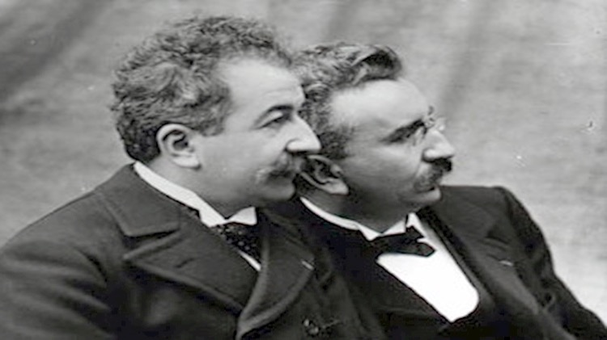
Lumiere Bros
French inventors of early motion picture camera and projector called the cinematographe from which the word cinema is derived.
1895 showing in Paris at Grand Café, series of short films, train arriving, people leaving workhouse etc.
Notes:
References:
https://www.britannica.com/biography/Lumiere-brothers#accordion-article-history

Slide 5
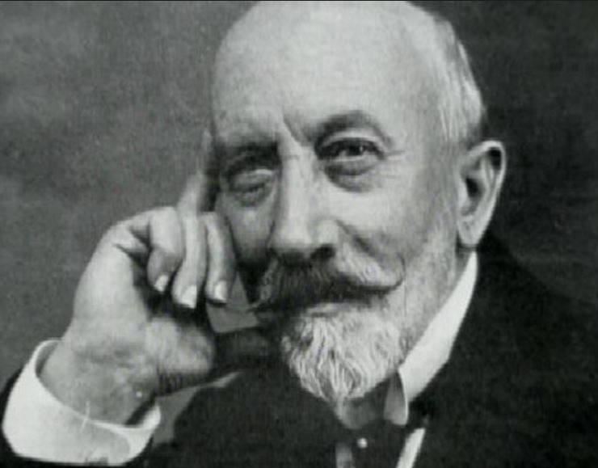
Georges Melies
French director and magician, producer of over 500 short films.
A Trip to the Moon 1902, inspired by the work of Jules Verne’s From the Earth to the Moon in 1865.
Pioneer in film special effects and film editing introducing the use of dissolve and fade transitions.
Notes:
References: http://www.filmsite.org/voya.html

Slide 6
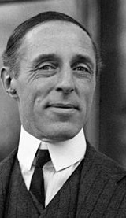
D.W Griffiths – The Birth of a Nation
American director of over 450 short films.
Perfected new cinematic devices including cross cutting, flashback, iris shot and the mask.
Experimenting with narrative in his short films, culminating in his magnum opus, ‘The Birth of a Nation’ in 1915.
Film received praise for it’s narrative vison but condemned for it’s blatant racism.
Notes:
https://www.imdb.com/name/nm0000428/bio?ref_=nm_ov_bio_sm

Slide 7
Rise of the Studio System: 1915- 1930
The Trust is dissolved 1917
Adolf Zuckor – Paramount Pictures
World War 1
United Artists 1919
Battleship Potemkin 1925

Slide 8
The Trust 1908 -1912
The Motion Picture Patents Company aka The Trust comprised of 10 movie producers and distributors seeking to gain control over the US motion picture industry.
Infamous for enforcing hard restrictions on independent filmmakers and theatre owners by refusing equipment. They also refused actors to be identified to avoid higher salaries.
The Trust was dissolved by court order in 1917 due to European and Independent producers outside the company.
Notes:
https://www.britannica.com/topic/Motion-Picture-Patents-Company

Slide 9
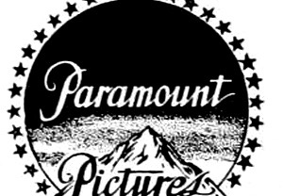
Adolf Zuckor
American entrepreneur and distributor.
Owned a chain of theatres between 1904-1912.
Created the company Famous Players which he then merged with Jesse Lasky to create Paramount Pictures.
Gave momentum to the star system concept paying his actors large salaries.
Notes:
https://www.britannica.com/biography/Adolph-Zukor

Slide 10
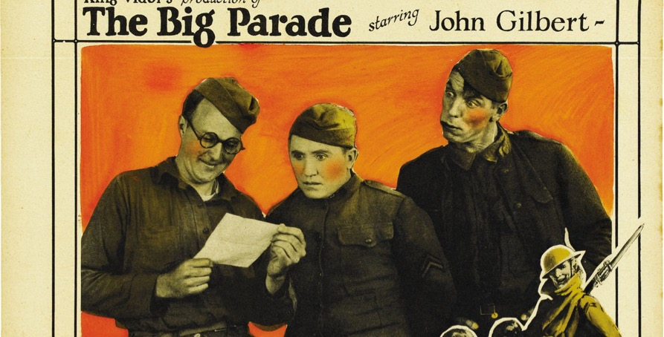
World War I
In 1914 the Austrian Archduke Franz Ferdinand is assassinated.
WWI lasts for four years, 8.5 million soldiers dead.
The film industry was heavily impacted by the war. Hollywood gained mass control over film markets owned by France and took talent from Germany.
Countless war films would follow, notable films including ‘All Quiet on the Western Front’ and ‘The Big Parade’.
Notes:
https://www.nytimes.com/2000/11/19/movies/film-how-the-first-world-war-changed-movies-forever.html
https://www.britannica.com/event/World-War-I

Slide 11
United Artists
Founded by Charlie Chaplin in 1919, along with Mary Pickford, Douglass Fairbanks both famous actors and D.W Griffiths.
Their goal was to be free to produce and distribute their own films. They also handled distribution of high quality films made by independent producers.
Prospered in 1920s, met financial difficulties in 30s & 40s and had to sell the production company and solely became a financial and distributing facility.
Notes:
https://www.britannica.com/topic/United-Artists-Corporation

Slide 12
Battleship Potemkin
Directed by Russian Director Sergey M Eisenstein in 1925.
Film is based on the mutiny of Russian soldiers against tyrannical superiors aboard the battleship Potemkin in 1905. their revolution is cut short in Odessa as Cossacks massacre them all.
Film is considered an international masterpiece, also notable for its filming techniques, such as the Odessa steps montage sequence.
Notes:
https://www.britannica.com/topic/Battleship-Potemkin

Slide 13
Golden Age of Hollywood: 1930 -1945
Jazz singer 1927
Big Five production companies
World War II
Haze Code – Censorship
Emergence of Television

Slide 14
Jazz Singer
American musical film released in 1927. it was the first feature length movie to have synchronized dialogue. It gave rise to the ‘talkie’ films and the decline in silent films.
The film is famous for the immortal line, “You aint heard nothin yet”, a symbolic line to usher in the era of the talking picture.
The film also features blackface, reminiscent of Birth of a Nation showing Hollywood still had issues of racism.
https://www.youtube.com/watch?v=22NQuPrwbHA
Notes:
https://www.britannica.com/topic/The-Jazz-Singer-film-1927

Slide 15
The Big Five
The Big Five refers to the 5 largest movie production companies of this era, Warner Bros, Paramount Pictures, RKO, MGM and 20th Century Fox.
These five studios would collaborate to reach national audiences. They would also share films to fill screens.
Their theatres would release over 100 films per year.
Notes:
https://hollywoodgoldenage.wordpress.com/2015/02/20/the-big-five/
http://www.csun.edu/~med61203/Big%205.pdf

Slide 16
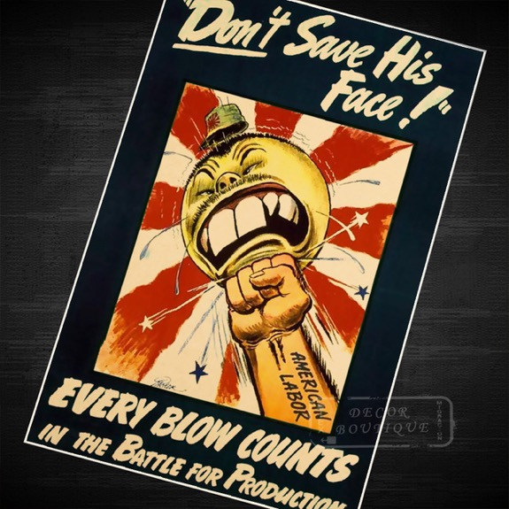
World War II
In 1939 Adolf Hitler invades Poland and sparks a second world war ending with Hitler’s surrender in 1945.
The film industry played a large role during this period, it helped to boost moral of troops. It also utilized the tool of propaganda, portraying Hitler and the Japanese in various insulting ways.
In the decades to follow many film would be made on WWII, notable examples include: Saving Private Ryan, Schindler’s List and A Bridge Too Far.
Notes:
http://americanhistory.si.edu/blog/hollywood-went-war-1941

Slide 17
The Haze Code
First published in 1930. It’s main goal was to introduce film censorship guidelines in the US for film producers.
The code affected film content from 1930 – 1966.
It would have affected elements in films such as profanity, violence, nudity, illegal drugs and crime.
Notes:
http://www.screenonline.org.uk/film/id/592022/

Slide 18
Emergence of Television
In 1930s, several broadcast stations began producing special programming.
The events of WWII negatively impacted the growth of the medium, dedicating all resources to the war effort.
By the 1950’s however television had replaced radio as the main broadcast medium in the home.
Notes:
http://www.elon.edu/e-web/predictions/150/1930.xhtml

Slide 19
The Foreign Wave: 1945 - 1970
Film protection laws
Cultural Significance
Andre Bazin – Auteur Theory
Japanese Cinema

Slide 20
Film Protection laws
Europe implemented film protection programmes. This was done for economic reasons, however it can also be seen as a response to American influence.
After WWII, America’s presence could be felt all across Europe. There was a lot of anti-American sentiment, fearing America was trying to colonise Europe.
Notes:
https://www.youtube.com/watch?v=Tw6N2_ET8_k&index=5&list=PLRtzd5eoxQ17k7Z7J6aMxY9Rzk4J1L3Cq

Slide 21
Cultural Significance
There was an increased focus on cinema as a form of art.
It was also seen as a chance of national expression.
Television hadn’t had the same impact in Europe as he had in America. Cinema was still the primary form of entertainment.
Notes:
https://www.youtube.com/watch?v=Tw6N2_ET8_k&index=5&list=PLRtzd5eoxQ17k7Z7J6aMxY9Rzk4J1L3Cq

Slide 22
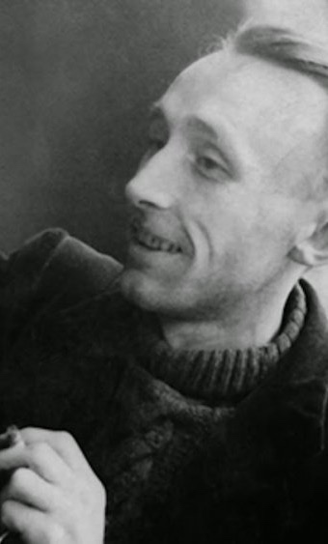
Andre Bazin
French film theorist and critic.
Famous for his work entitled, “What is Cinema”? A 1967 publication of his articles discussing cinema.
Andre Bazin sought to present cinema as a form of art and a form of knowledge.
His perpetuated his theory of realism in film and that cinema could be something more than mere entertainment.
Notes:
https://www.bfi.org.uk/news-opinion/sight-sound-magazine/features/andre-bazin-divining-real-film-criticism-overview

Slide 23
Japanese Cinema
In the 1950’s Japanese cinema flourished.
The film that sparked this rise is Akira Kurosawa’s , Rashomon. This film helped bring Japanese cinema to a wider audience.
It would Kurosawa again who would grab attention from Western filmmakers and audiences with his magnum opus, Seven Samurai. A film held as one of the best ever made. It’s influence cannot be understated spawning remakes and adaptions from Kurosawa’s core story.
Notes:
https://www.criterion.com/current/posts/920-Rashomon
https://www.bfi.org.uk/news-opinion/news-bfi/features/still-crazy-good-60-years-seven-samurai

Slide 24
New Hollywood: 1960 - 1985
Film school brats
Birth of Blockbuster
Television boom
Relaxed Censorship

Slide 25
Film School Brats
This refers to the group of up and coming movie directors who learned their craft through film school and influences from films both domestic and foreign.
Famous examples include Francis Ford Coppala, George Lucas and Steven Spielberg.
Lucas and Spielberg in particular would go on to influence the world of cinema with the era of the blockbuster.
Notes:
https://www.empireonline.com/movies/features/movie-brats-movie-era/

Slide 26
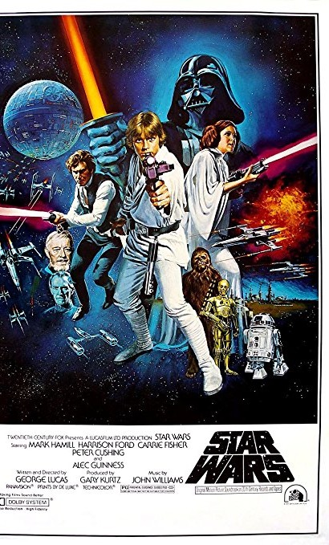
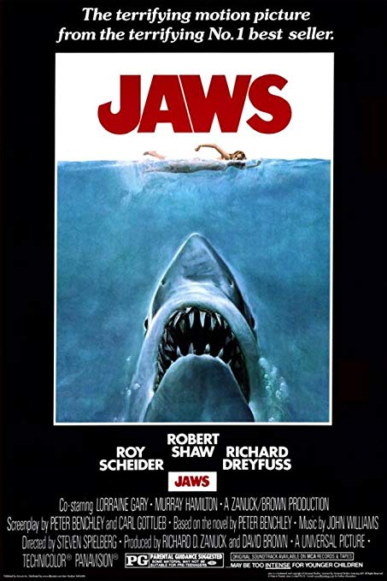
Birth of the Blockbuster
Many would credit the birth of the blockbuster with Steven Spielberg’s classic film, ‘Jaws’ in 1975. Through heavy promotion and a nationwide release, Jaws saw huge financial success which spurred on studios to continue this trend.
Only a mere two years later, George Lucas presented his classic, ‘Star Wars’, like Jaws Star Wars was met with huge financial and critical success. George Lucas also popularized the concept of film merchandise, through toys, collectibles games etc.
Blockbusters have now become a staple of film culture with large films being released during the summer to bring in large numbers to cinemas.
Notes:
https://filmschoolrejects.com/summer-blockbuster-origins/

Slide 27
Television Boom
During the 1960s television was becoming more common place and with the film industry going through a rough period financially, studios turned to television to produce tv films and series.
The film industry was struggling, with a lot of its old directors retiring or passing away. Studio bound contract stars and directors were a thing of the past.
Studios made several attempts to keep interest in film with studio tours and creating the famous Hollywood walk of fame.
Notes:
http://www.filmsite.org/60sintro.html

Slide 28
Relaxed Censorship
The 60s saw the censorship of film challenged. Hitchcock’s Psycho saw to test these censors, with a peeping tom sequence, an onscreen flushing toilet and the violent murder of the main character.
Many traditional movie genres, such as the western, gangster and horror displayed increased levels of violence and adult content.
Famous examples include, The Graduate 1967, The Exorcist 1973, A Clockwork Orange 1971.
Notes:
http://www.filmsite.org/60sintro6.html

Slide 29
Contemporary Cinema: 1995 - Present
Company Monopolies
Digital technology
3D
Streaming Services

Slide 30
Company Monopolies
In recent years different production companies have bought other companies forming small monopolies.
The most substantial of these companies would be Walt Disney. Disney owns several production studios including, Pixar animation studios, Marvel Studios and Lucas Arts Ltd. In 2018 Disney also brokered a deal to purchase 20th Century Fox.
This has lead to some backlash with many feeling this level of control over such studios with little competition will harm the industry.
Notes:
https://screenrant.com/disney-owned-brands-properties-trivia/

Slide 31
Digital Technology
Digital technology has permanently changed the way films are made and distributed.
Many aspects such as cost, digital eliminates the use of film canisters, it allows shoot schedules to be completed with less waste and therefore save money.
Editing is easier with computer programmes to control sound, visual effects and can piece the films scenes together in a more manageable fashion.
Notes:
https://www.wired.com/insights/2015/01/how-tech-shaped-film-making/

Slide 32
Digital Technology
Shooting film is easier, multiple cameras can run on the same shot, allowing you to get multiple angles and reducing retakes.
Distribution has been affected, through the multiple ways films can be distributed. This particularly applies to indie filmmakers presenting work on platforms like YouTube. Many film companies upload their trailers to YouTube to reach larger audiences.
Notes:
https://www.wired.com/insights/2015/01/how-tech-shaped-film-making/

Slide 33
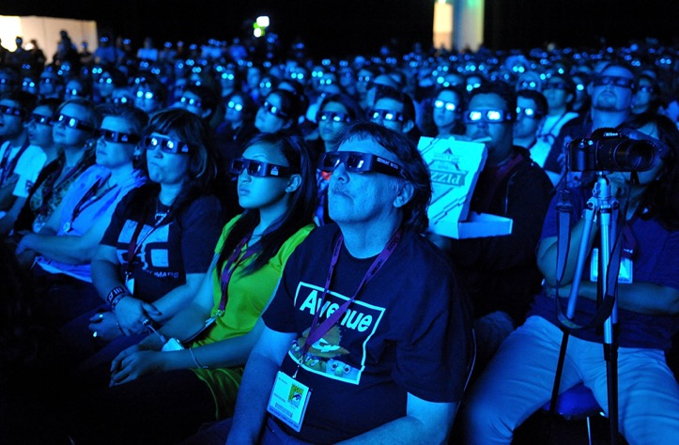
3D
Films in 3D is not a new technique. It was experimented with as early as 1922 with the film The Power of Love, considered the first 3D film.
Over the following decades the technology of 3D is improved however the concept of 3D isn’t widely used.
From the 70s to the 80s sees a large boom in 3D films mainly used for sequels, remakes or B films.
3D films saw another boom in the early 2000s with both new films and releases being shown in 3D as well as 2D. In the past few years however 3D is on the decline again with no more than a couple of films per year being shown in 3D.
Notes:
https://www.theguardian.com/film/2009/aug/20/3d-film-history

Slide 34
Streaming Services
New services have emerged that allow you to stream hundreds of films and TV series from your laptop, TV or gaming device.
Since Netflix popularised this service, many companies have followed suit creating their own streaming service.
These services have had an impact on the sales of physical copies of films, DVDs and Bluray.
Notes:
https://www.radiotimes.com/news/2016-04-07/tv-and-film-on-demand-guide-which-streaming-service-should-you-choose/

Slide 35
Virtual Reality (VR)
Virtual Reality is still a fairly new technology however it has been ustilised in both short films and gaming.
Pink kong studios, created a short film that is a story driven VR experience called Aurora.
With projects like Aurora, it shows a great foundation to the potential of VR within film.
Notes:
http://www.pinkkongstudios.ie/aurora.html
http://www.pinkkongstudios.ie/assets/aurora_email_sig.jpg
http://animationireland.com/wp-content/uploads/2016/03/pink-kong_331.png

